Slide 1

PyHC + Summer School Introduction
Julie Barnum
LASP/University of Colorado Boulder
PyHC 2024 Summer School, 20 May 2024

Slide 2

PyHC Mission Statement
Promote sustainable open-source Python software;
Improve communication and collaboration between disciplines, developers, and users;
Establish/maintain development standards;
Foster interoperability and reproducibility

Slide 3


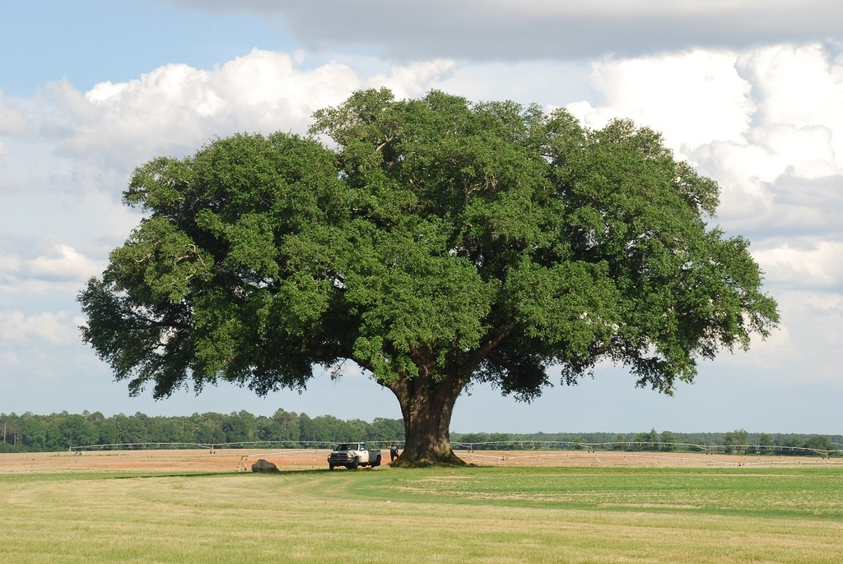


PyHC, a Grassroots Effort

Slide 4
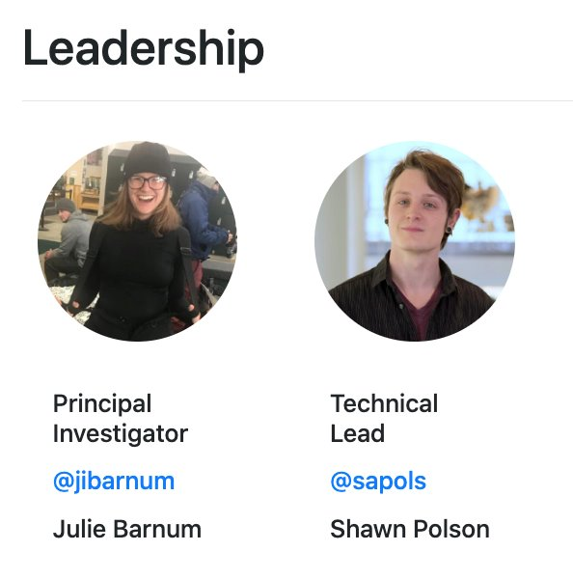
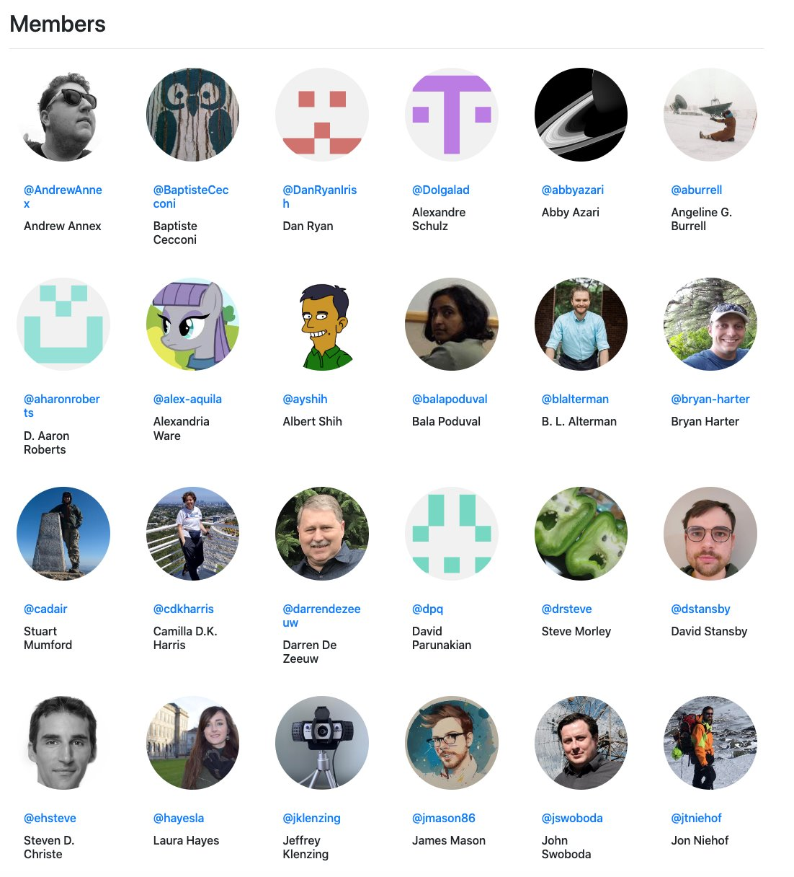
Organizational structure
Leadership team ✅
Steering committee 🚫 (ish)
Regular communications ✅
One package to rule them all 🚫
Effort consolidation where possible ✅
* not all-inclusive
Notes:
The study of heliophysics spans a number of different sub communities, each with its own heritage of
instrumentation and software practices. It is not expected that a single package could successfully meet
the needs of the whole community. There are different technical challenges within each discipline that
necessitate different solutions and different approaches to science software. For example, solar
measurements are largely dominated by remote images however ionosphere/thermosphere measurements
can include remote images, radar measurements, in situ satellite based measurements, all-sky ground
based cameras, GPS networks, magnetometer networks, etc. A single package that tried to solve all
problems for everyone will likely not work for anyone
Unlike astropy, etc. That do have one package (and perhaps affiliated packages).

Slide 5







PyHC Projects
83 packages
Core Packages
PlasmaPy, SunPy, SpacePy, pysat, HAPI, Kamodo, pySPEDAS
Other & Un-Evaluated Packages
Domains
Solar, Heliospheric, and Geospace Sciences (Magnetosphere) and ITM
Model output analysis, ML, plotting, wrappers for other libraries, CDF writers, etc.
https://pyhc.org
Notes:
Where are we at now?
Core packages
PlasmaPy – Python package for plasma physics
SunPy - Python for Solar physics
SpacePy – space science library for Python. Includes file I/O, time and coordinate conversions, common analysis techniques
pysat – management and analysis tool for satellite and radar data
Kamodo - CCMC tool for access, interpolation, and visualization of space weather models and data
pySPEDAS - Tools for loading, analysis and plotting of data from various heliophysics missions and ground magnetometers
HAPI client - Access time series data access from many sources

Slide 6
Summer School Agenda
Day 1:
Plenary talk, HelioCloud intro, AstroPy, SunPy, PlasmaPy
Day 2:
PySPEDAS, SpacePy, pysat, Kamodo, MadrigalWeb
Day 3:
Time + coords in PyHC, “How To” sessions, panel session, and posters
Day 4:
Multi-package use cases, PyHC Challenge Ladder (prizes! 👀)
Day 5:
ML in Helio, searching for data, wrap up
Lunch is on your own

Slide 7
Summer School Extras
Day 2:
Self-sponsored reception at Avanti
address to be put in Slack #social
Day 3:
Self-sponsored fun activity
Escape room (~$28) or axe throwing (exact price depends on # of people)
Sign ups for both are on sheet at the front of the room. First come, first serve basis. 16 max for escape rooms, axe throwing has a bit more flexibility
Day 5:
Hike after lunch
I’ll throw a few options in #social

Slide 8
Summer School Etiquette
All attendees are expected to follow the PyHC Code of Conduct at all times.
https://heliopython.org/docs/code_of_conduct/
Violations could result in dismissal from the Summer School.
Zoom
Please don’t share the link with anyone else not a part of the summer school
Stay muted if not asked to unmute
Issues with/questions about HelioCloud?
Virtual: ask in #tech-questions
In-person: ask our HelioCloud rep, or ask in #tech-questions
Presentation questions?
Virtual: ask in Q&A on Zoom (not in the comment section)
In-person: use microphones (raise hand), can also use Q&A in Zoom
Both: for non-immediate questions, ask in separate package channels in Slack
General Summer School questions?
Post in the #general chat in the Summer School’s Slack Space (desired)
Email: pyhc-confidential@lasp.colorado.edu

Slide 9
Saving HelioCloud Content
To save everything as a local copy to your machine
In HelioCloud, go to New Launcher -> Terminal, which creates a linux terminal
Zip all the files there with “zip myfiles.zip -r summer-school/” (where ‘myfiles.zip’ is whatever you want to name your archive)
Once that finishes (it takes a while; lots of data there) you can go back to the HelioCloud file browser (right side) and in your home directory is ‘myfiles.zip’. Select it and right-click to Download to your local machine.
Once you’re home, unpack and you can continue working with them (install Jupyter etc to use locally)
Make sure to save every by next Wednesday, May 29th EOD (MT)
You can also get at all the notebooks/content from the summer-school GitHub repository
https://github.com/heliophysicsPy/summer-school

Slide 10
Miscellaneous
Parking
Passes required, if you haven’t gotten one and are parking on campus, head to the front desk
Restrooms
Past main entrance area to the right and turn right down the hallway. First couple sets of door to the right.
Lunches
Sign ups at front for being willing to drive people to lunch and/or pick up food orders.
There is Etais nearby, but might get overwhelmed with all of us there
If you post on SM, use the #pyhcschool24 hashtag
We have stickers for you all 🫡

